Slide 1
Deep Learning WSI Tutorial
Isaiah Pressman, CCF

Slide 2
Pipeline Outline
Libraries & Environment
Data Preprocessing
Tiling
Filtering out background tiles
Macenko normalization
Tumor detection
Training Deep Learning Models
Data splitting
Model and data loading
Main training loop
Evaluating & Visualizing Performance
Patient-level vs. tile-level evaluation
Visualizing performance over time

Slide 3
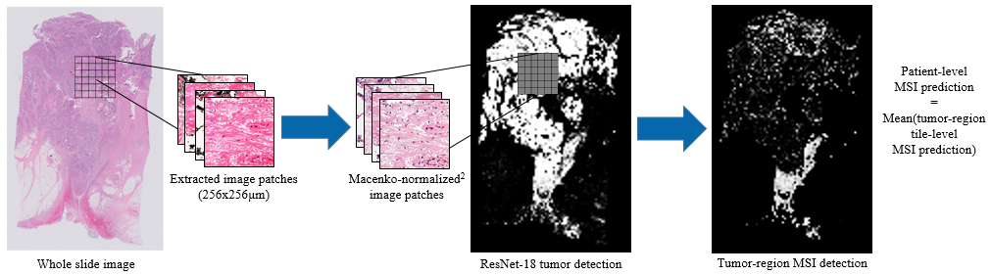

Slide 4

Libraries & Environment
Most of the packages needed are part of the standard python data science ecosystem. (numpy, scipy, scikit-learn, scikit-image, etc.)
The only special package is OpenSlide, a library for reading whole slide images in Python.
When installing OpenSlide on Linux, it won’t work correctly for some slide formats unless you also install a specific version of libpixman

Slide 5
Data Preprocessing
In order to prepare the WSI images for deep learning training and inference, a number of preprocessing steps must be applied:
Images are broken into many small tiles (usually 256x256 microns)
Tiles are filtered to exclude non-tissue background regions
Tiles are Macenko-normalized
Tiles are filtered to exclude non-tumorous tissue regions
When applying this pipeline at scale, the implementation should include multiprocessing and/or CuPy (for Macenko normalization) as these additions provide enormous speedups.

Slide 6
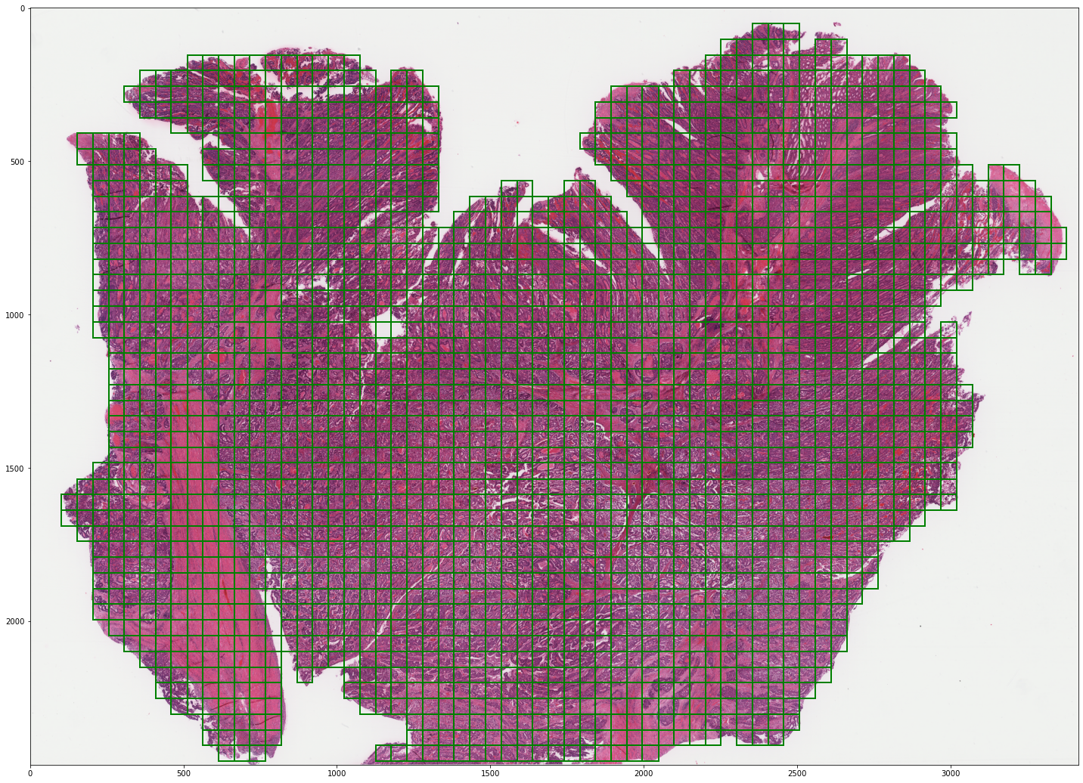
Example WSI with tiles

Slide 7
Training Deep Learning Models
The deep learning model pipeline consists of three main steps:
Data splitting
Model and data loading
Training loop
Performing inference
Calculating loss
Backpropagating loss
Updating parameters
Logging results

Slide 8
Evaluating & Visualizing Performance
Models are trained and validated at a tile level. Ultimately however, the goal is to make decisions at a patient level.
To convert a tile-level prediction to a patient-level one, we simply take the mean tile-level prediction.
This is not the only way, nor necessarily the best way, to make a patient-level prediction, and could probably use improvement. (Multi-instance learning, for example, is another way to go about things)
One should watch model train vs. validation performance to look for overfitting

